Slide 1
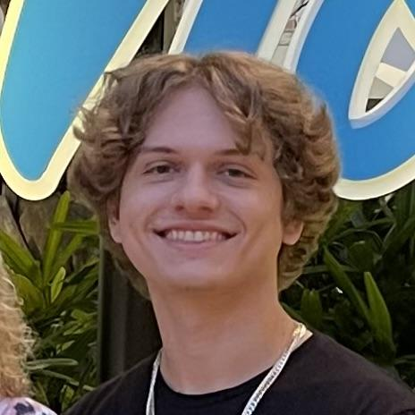

Project E-Bike
UCF College of Engineering and Computer Science
Alexander Gilbert
Carlos Curbelo
Victor Petrillo
Christopher Rumpf
Electrical Engineering
Electrical Engineering
Computer Engineering
Computer Engineering
Notes:
Hello! Welcome to Group 12’s CDR Presentation. The purpose of this presentation is to detail the motivations and design/build processes, as well as how the project has evolved/change since its conception in Senior Design 1.

Slide 2


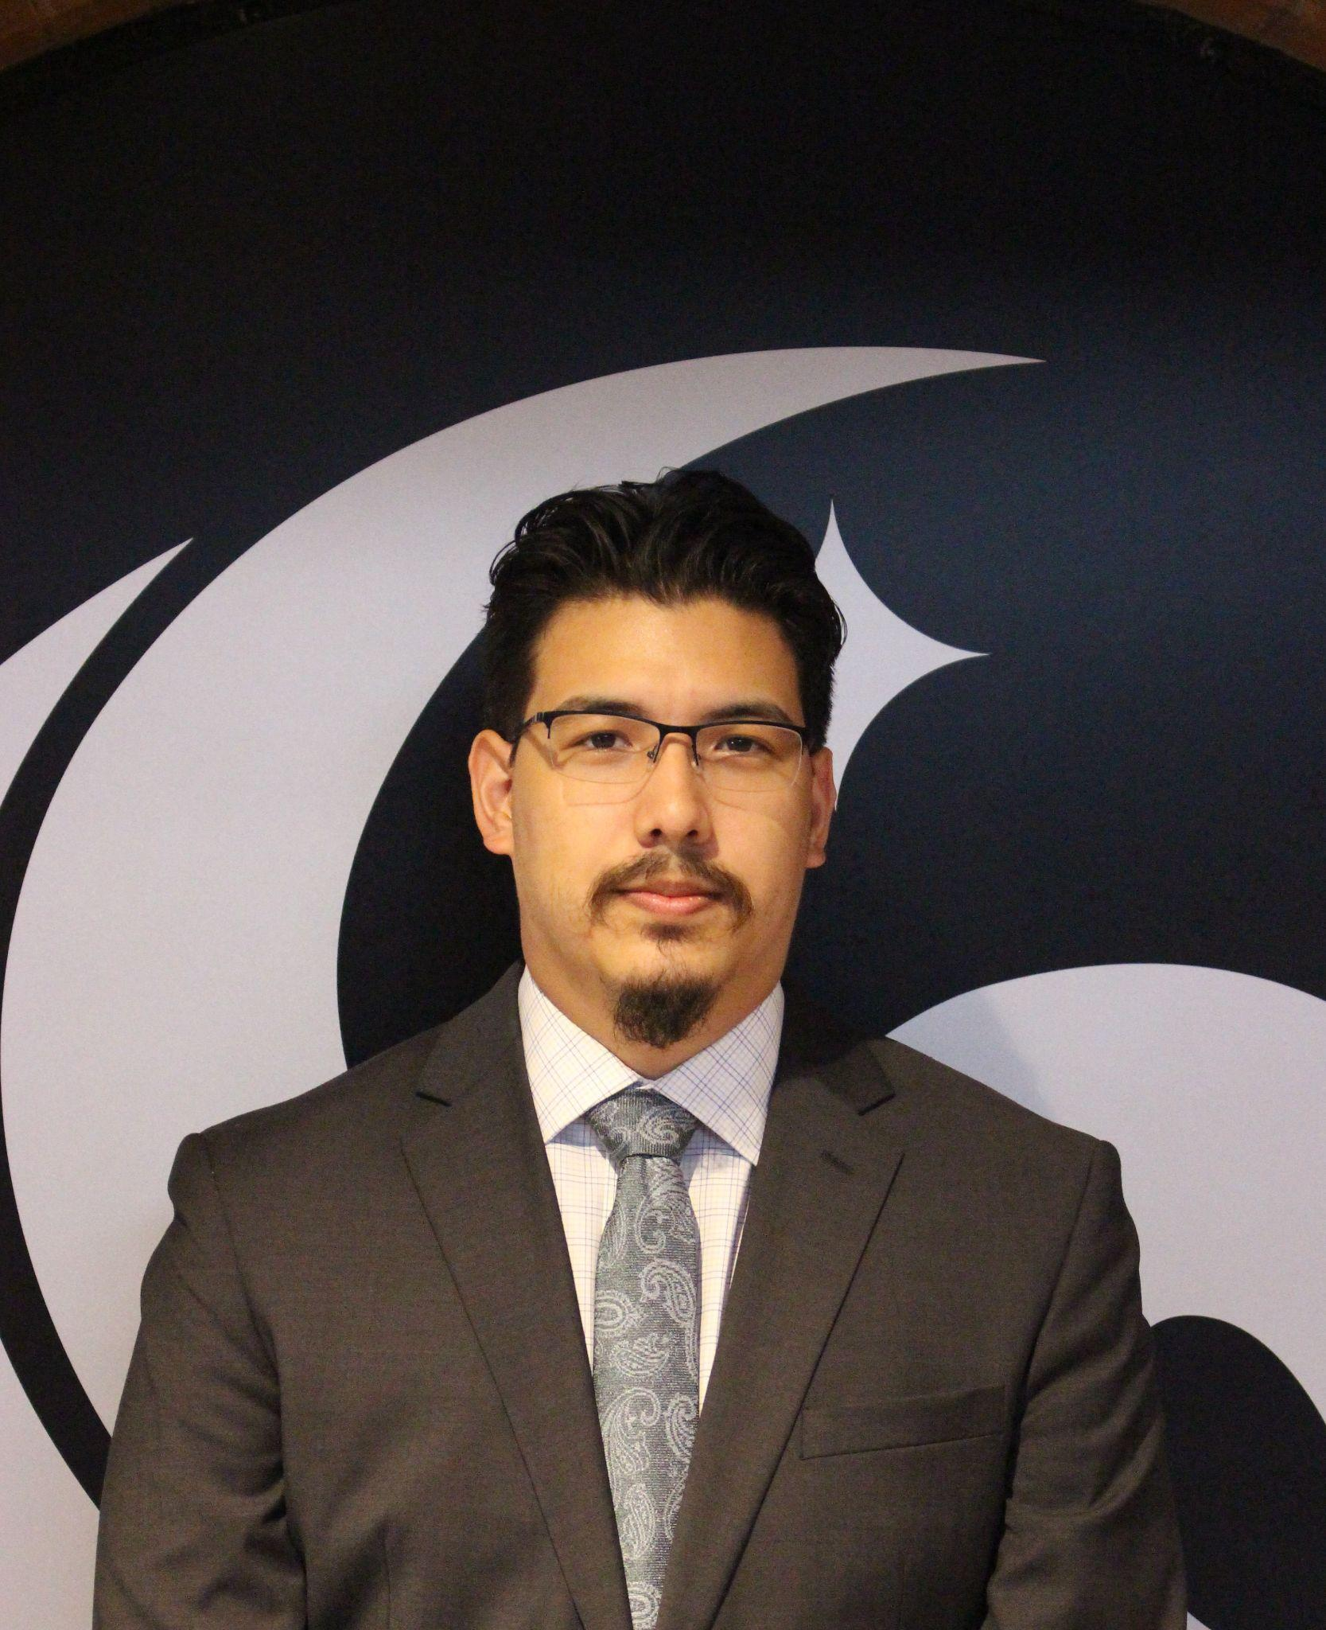
The Team
Alexander Gilbert
Electrical Engineer
Carlos Curbelo
Electrical Engineer
Christopher Rumpf
Computer Engineer
Victor Petrillo
Computer Engineer
Notes:
This is the team, group 12. We consist of two electrical engineers, Alex and Carlos, and two computer engineers, Christopher and Victor.

Slide 3
Motivation and Background
USA’s dominant transportation method is automobiles
Other methods are either:
Inconvenient
Inefficient
Electric bicycles are growing in popularity
Cheaper
Easier to maintain
Strive to contribute to/meet expectations of modern e-bikes
Modern technology
Smartphone connectivity
Notes:
The motivation behind this project is mainly to contribute/meet the current modern expectations of electric bicycles.
Personal cars are a great choice for transportation in the United States
-Most cities/areas in the USA are very spread out and have strong road foundations to allow for gasoline-powered automobiles
-lack foundations for sidewalks occasionally
-This unfortunately renders other transportation methods like walking or traditional bicycles either inconvenient or inefficient
-traditional bicycles can get tiring and can even be considered useless if people are not physically able to bike to their destination
-not the case in heavily urban areas like downtown areas with tightly packed buildings and large sidewalks
These are great supporting facts for why electric bicycles are growing in popularity
-they are a significantly cheaper alternative to cars
-may not require insurance
-certain categories of e-bikes do not require registration
-also incredibly easier and cheaper to maintain than cars
-cars can run up to multiple thousands of dollars to maintain/repair
-e-bikes are significantly cheaper in maintenance cost
With this project, we strive to either contribute to or meet expectations of modern e-bikes
-we are using modern technology to convert a traditional bicycle into an electric bicycle
-includes a smartphone application that connects to bicycle via bluetooth

Slide 4
Goals and Objectives
Engineering Goals | Description
App | Mobile app to control settings and display relevant info.
Throttle Control | Use a throttle to control speed of bike.
Lighting | Lights for night time riding and regulatory compliance.
Stretch Goals
Cruise Control | Set the bike’s speed and not use throttle control.
Assist Mode | Still have to pedal, but long distance or hills easier.
Notes:
Carlos

Slide 5
Comparison and selection of hardware
Motor
MCU
Battery
Bluetooth Module

Slide 6
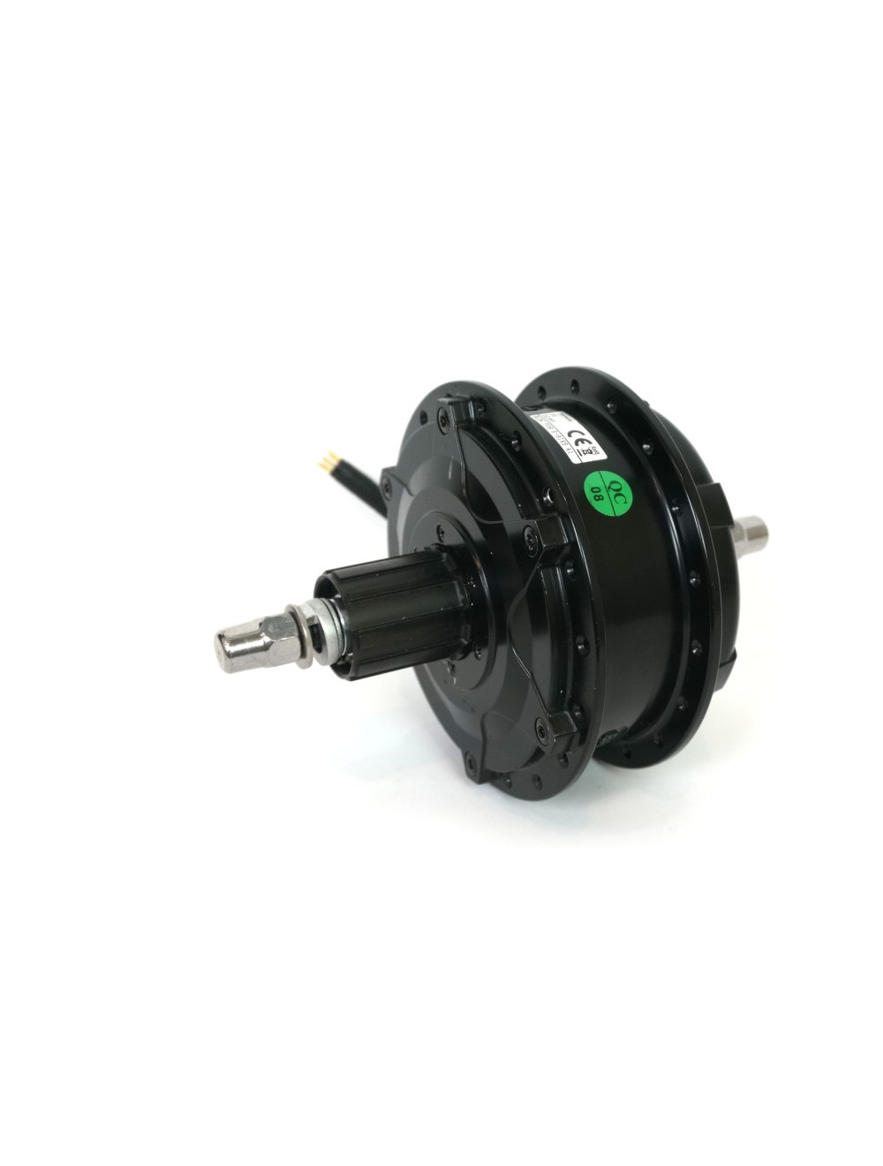
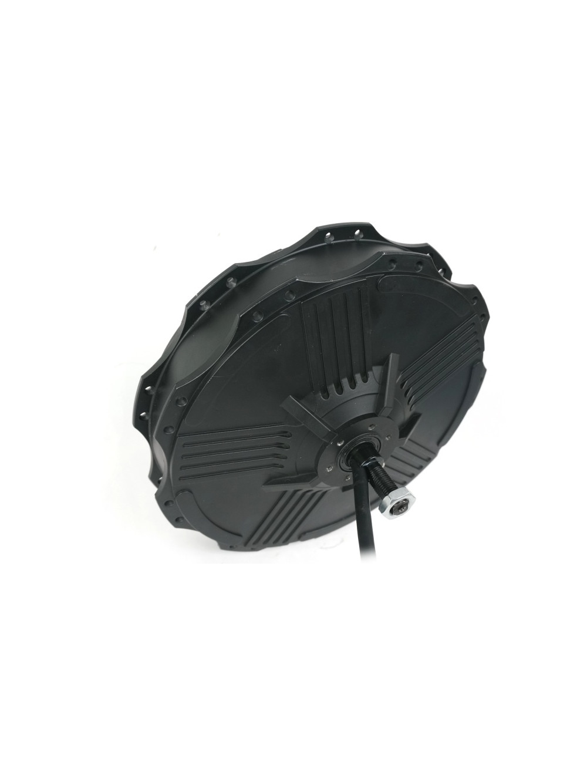
Motor
Bafang G310
RH212
$215
250-500 Watt
Internal Gear Reduction
https://ebikes.ca/shop/electric-bicycle-parts/motors/mg310_std.html
$260
600-1200 Watt
Direct Drive
https://ebikes.ca/shop/electric-bicycle-parts/motors/rh212-std-wind-hub-motor.html

Slide 7
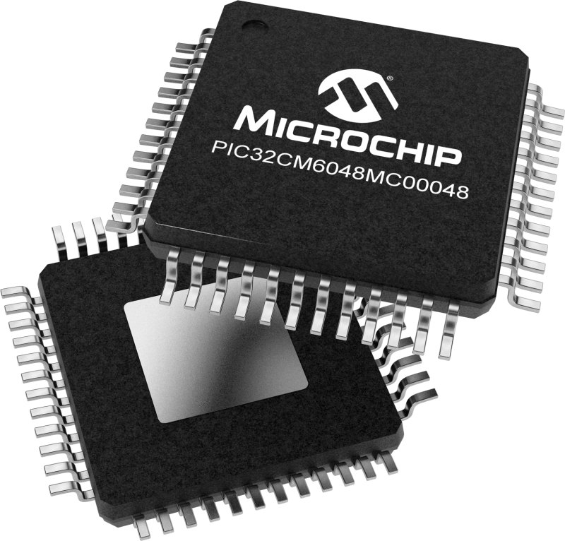
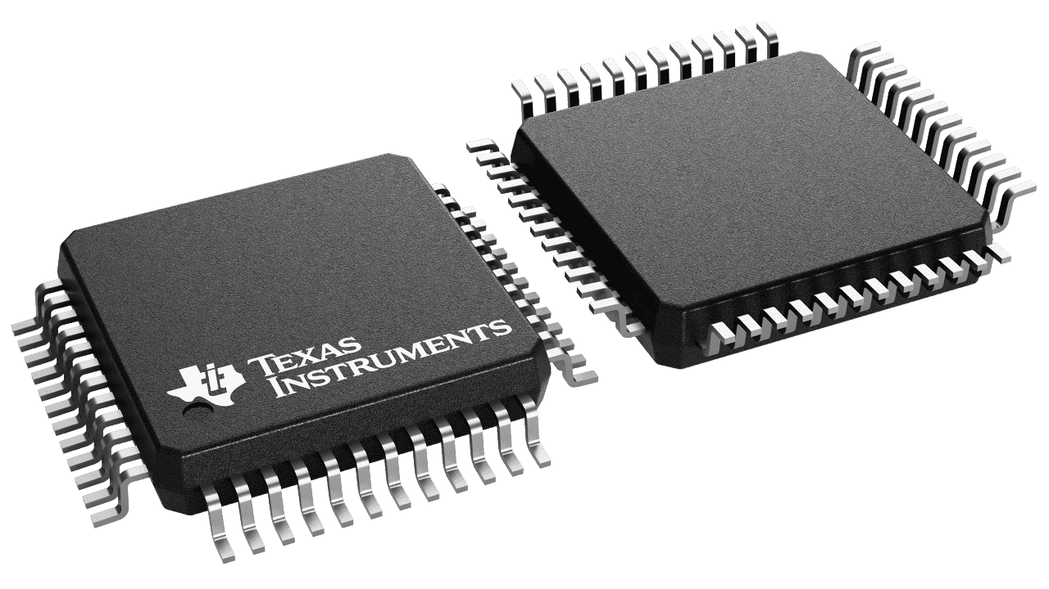
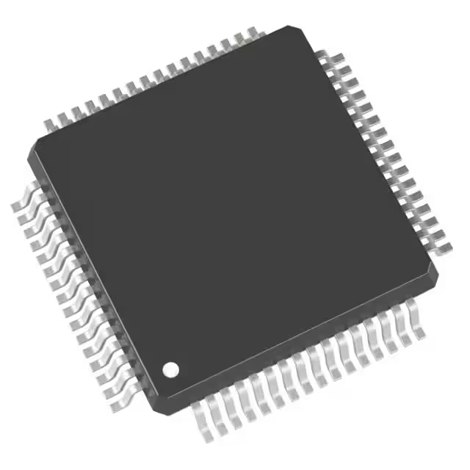
MCU Selection
STM 32
MSP 430
PIC 32
MCU | PIC32CM1216 | STM32F405 | MSP430FR2355
Architecture | ARM Cortex M0+ | ARM Cortex M4 | MSP430 core
Max Word | 32-Bit Single-Core | 32-Bit Single-Core | 16-Bit
I/O Pins | 38 I/O | 51 I/O | 44 I/O
Memory | 128KB Memory | 1MB Memory | 32KB
Operating Voltage | 5V | 3.6V | 3.6V
Max Speed | 48MHz | 168MHz | 24MHz
Program IDE | MPLAB | STM32 Cube | Code Composer Studio

Slide 8
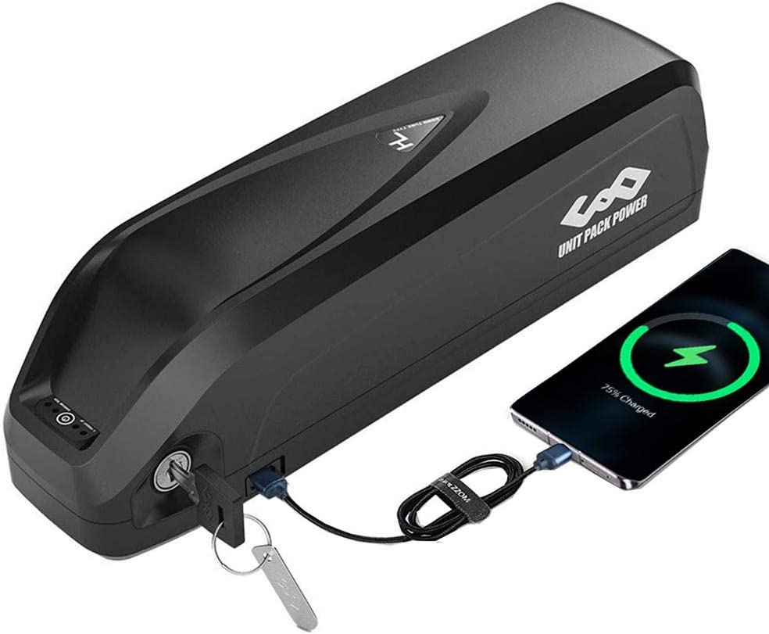
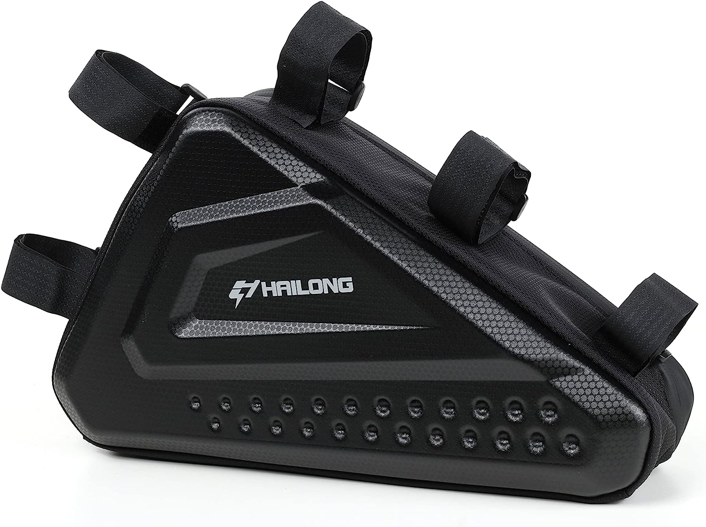
Battery
36v 20ah 0-700W
36v 20ah 200-800W

Slide 9
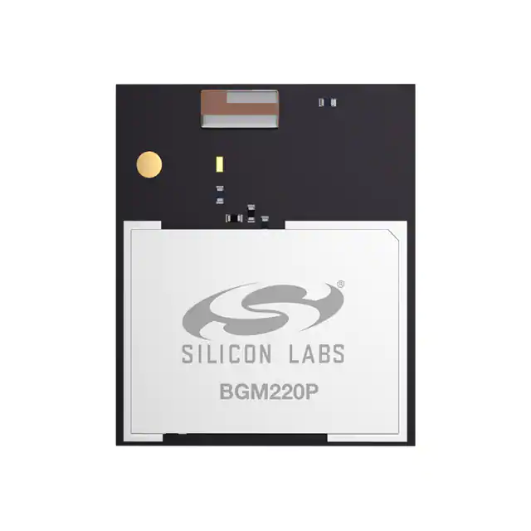
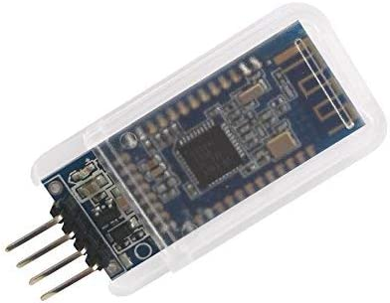
Bluetooth Modules
SI Labs BGM220
Bluetooth v5.2
Multi-Protocol
DSD HM-10
Bluetooth 4.0 BLE
UART

Slide 10
Hardware Design
Block Diagram
PCB Design

Slide 11
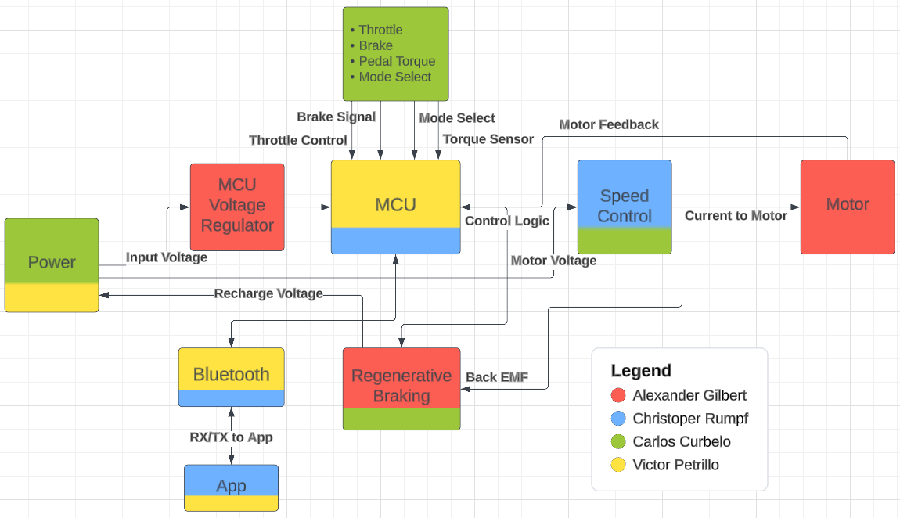
Block Diagram

Slide 12
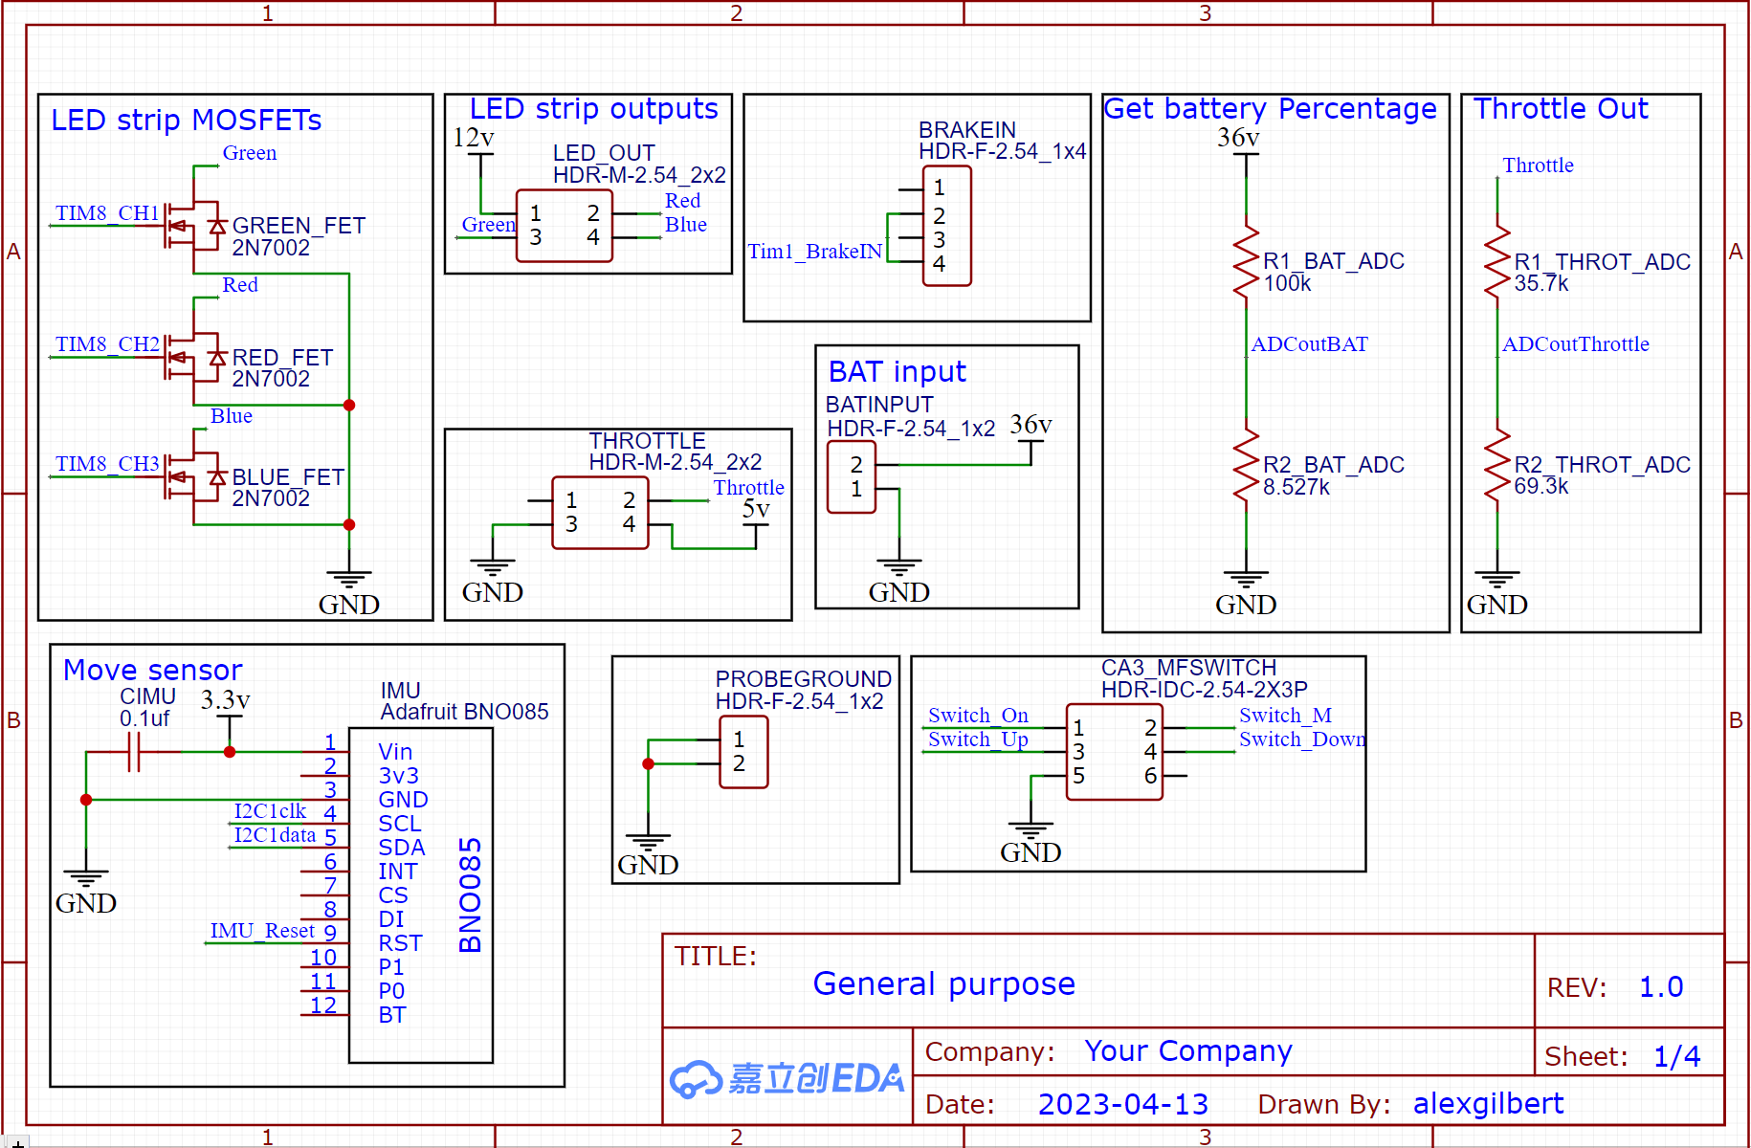
PCB Schematic
Input/Outputs

Slide 13
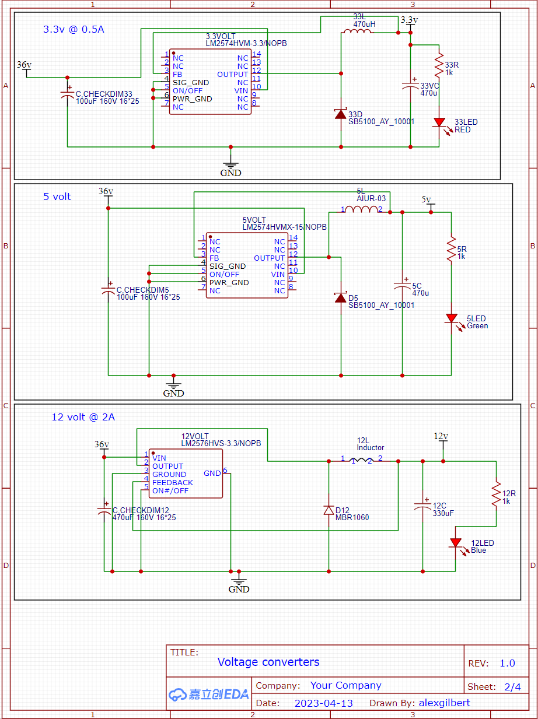
PCB Schematic
Need three voltages

Slide 14
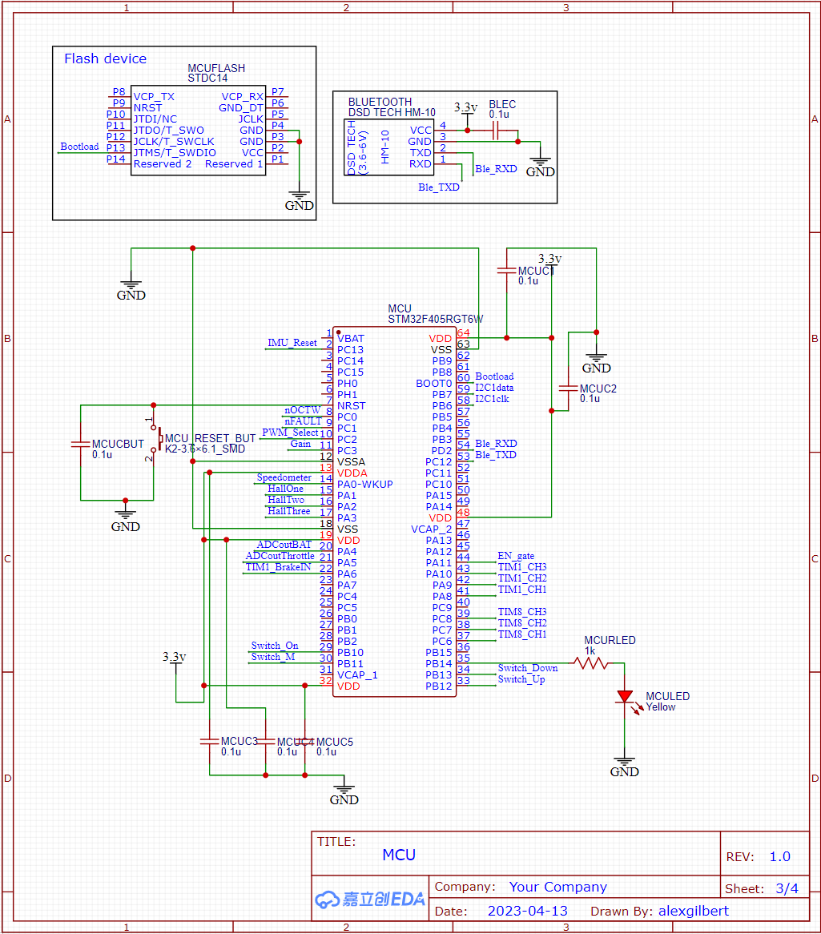
PCB Schematic
MCU and Bluetooth

Slide 15
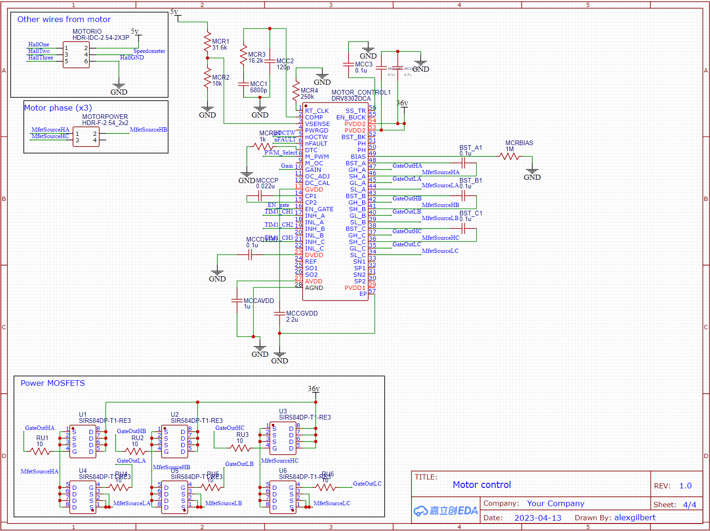
PCB Schematic
Motor control

Slide 16
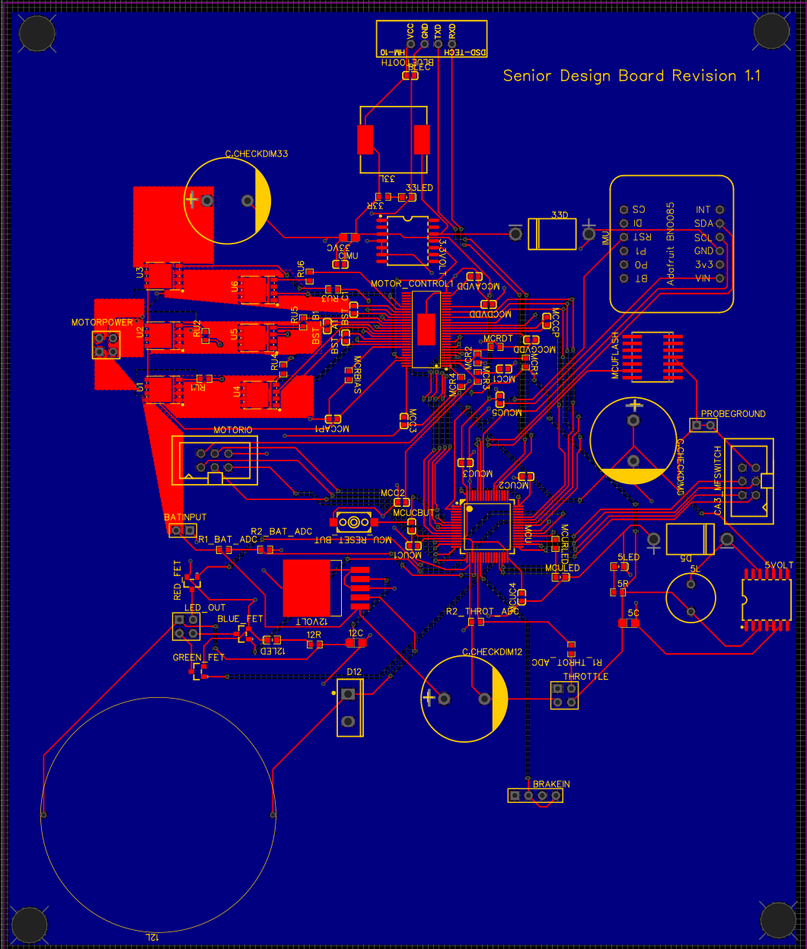
PCB layout
175.6mm by 148.7 mm

Slide 17
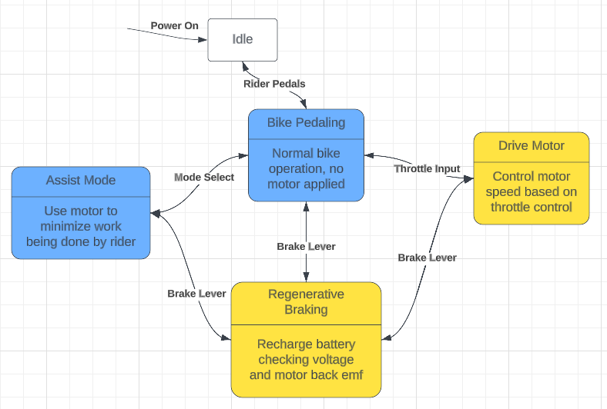
Software State Diagram

Slide 18
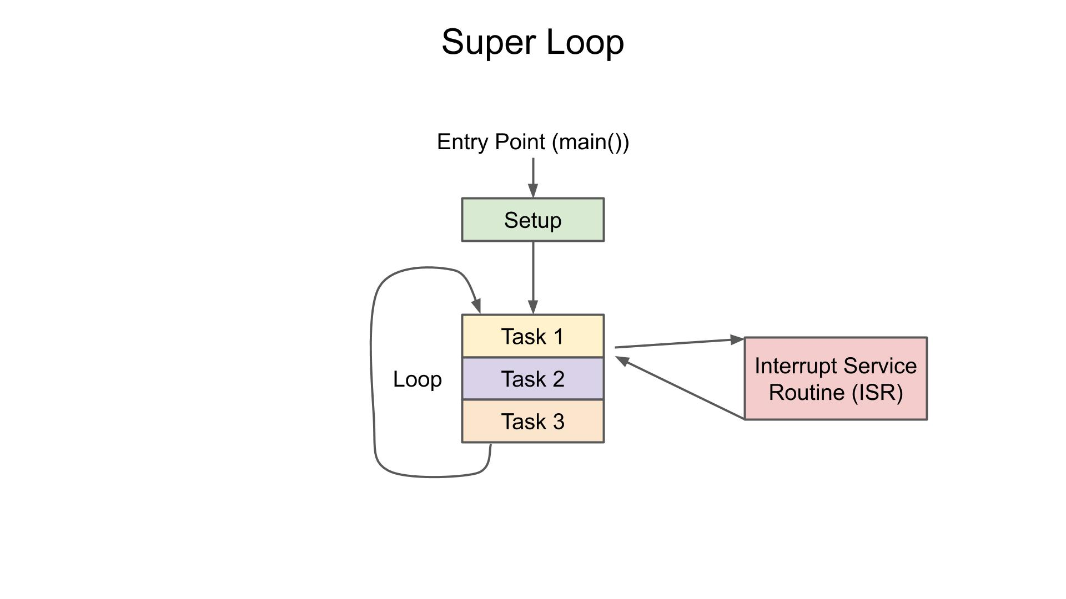
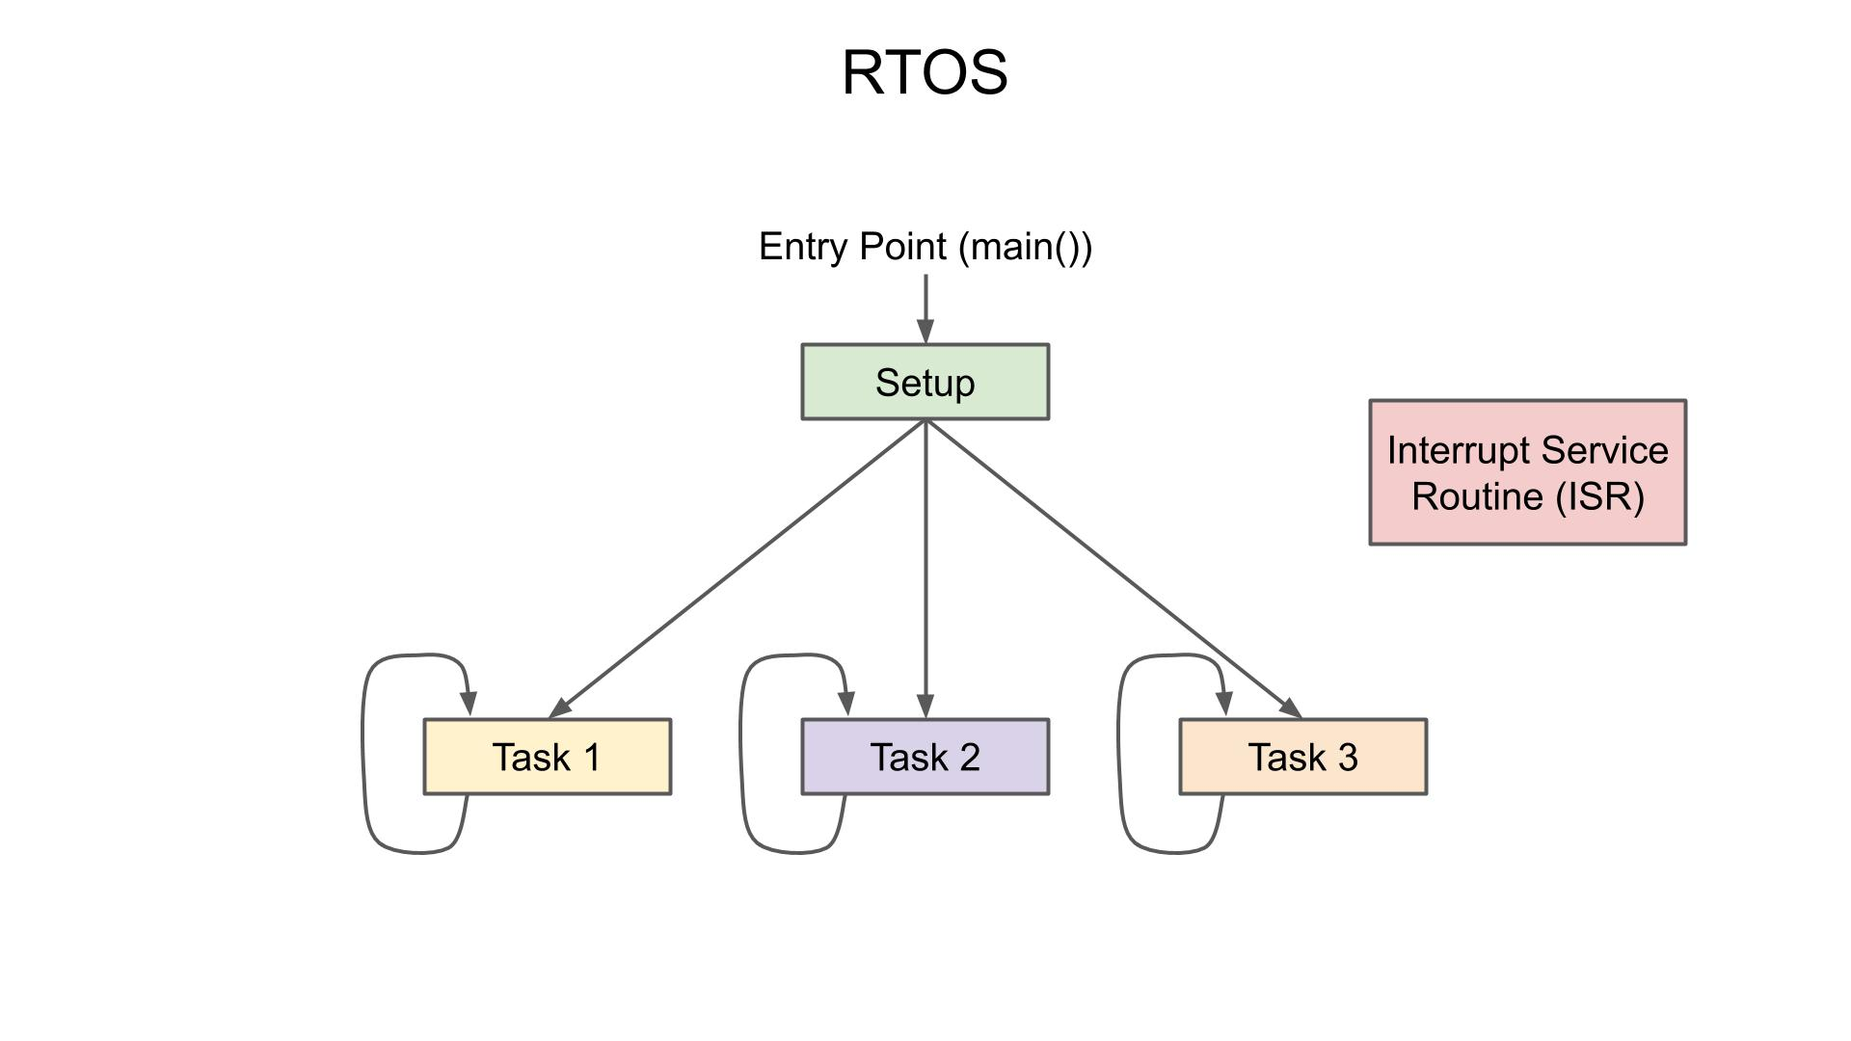
MCU Programming Structure
Images: https://www.digikey.com/en/maker/projects/what-is-a-realtime-operating-system-rtos/28d8087f53844decafa5000d89608016

Slide 19
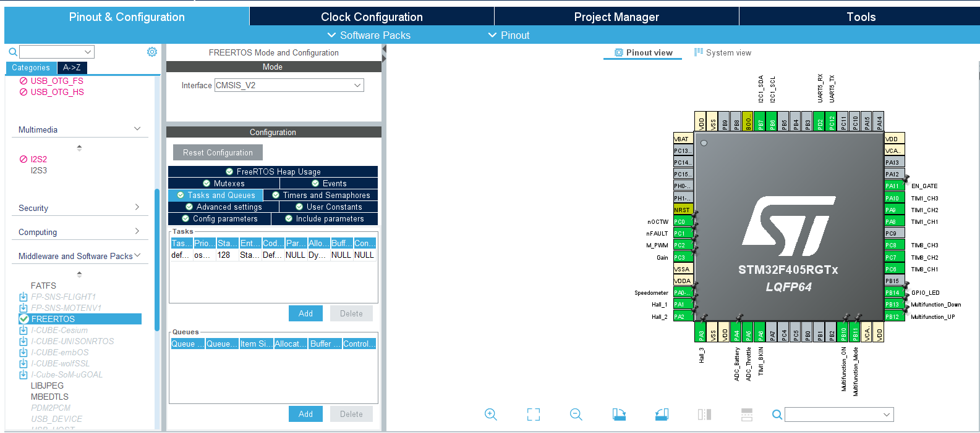
MCU Configuration

Slide 20
Tasks
Motor Control - Realtime
osPriorityRealtime
osPriorityHigh
osPriorityAboveNormal
osPriorityNormal
osPriorityBelowNormal
osPriorityLow
Bluetooth Comm. - High
IMU - AboveNormal
Battery Voltage - AboveNormal
LED Lights - Normal
Motor Speed - ISR

Slide 21
Bluetooth Packet
{
Gyro: yaw, pitch, roll
Acc: x, y, z
Battery: voltage
Speed: mph
Mode: current mode
}

Slide 22
Application Development Approach
Technology selection was ease-of-use driven
Both developer and user experience
 | Web Application | Smartphone Application
Pros | Accessible on any device (if desired) Great documentation on available technology Cross-platform | Downloaded to device No network connection required Also (potentially) cross-platform
Cons | Requires server hosting Requires network connection Not developed specifically for smartphone | Relatively newer tech to web apps Potentially less documentation
Notes:
The application’s technology had to be selected before designing or developing could begin.
Two approaches to development were considered: a web application and a smartphone application. While both approaches presented their own arguments for why it should be taken, all points must be considered; including a smooth development process as well as ease-of-access.
The web application approach would provide ease-of-access to the user by allowing it to be accessible on any device. This would not only means any internet-capable device could take advantage of the application, but also implies cross-platform capabilities. However, since this is a web application, it would require server hosting which prove not only tricky to accomplish, but also potentially introduce more cost into the project, since third-party hosting websites tend to charge users for hosting capabilities.
The smartphone application approach would provide not only ease-of-access to the user, but also could prove to smoothen the development process. This approach would eliminate the need for server hosting, since the application would be downloaded to the user’s device. Although, smartphone applications are relatively newer technology compared to websites, and this can prove to provide less documentation/community support for issues that may arise.

Slide 23
Application Technology Selection
 | iOS (XCode, Swift) | Android (Android Studio, Java/Kotlin) | Flutter (Dart)
Pros | Most group members have iPhones Easy to work with Apple’s support | Runs natively on both Windows and MacOS Great community support | Is cross-platform Enables every member to test Great documentation (Google developed)
Cons | Does not run natively on Windows | One Android phone in group; limits testing Kotlin an unfamiliar language | Dart is a new language to both community a the group Steep learning curve
Flutter was selected to support application development
No data collection, no database
Notes:
After deliberation over the technology approach, the smartphone application was selected as the approach that supports the group’s requirements, greater so than the website application.
With smartphone application development, a main technology needs to be selected in order to drive development. With a smartphone application, there are a few different choices.
iOS
-apple is big company and has great support and documentation
Android
-android is open source and much more community friendly
Flutter
-although a steep learning curve, it would prove the most useful due to (reasons on slide)

Slide 24
Flutter Libraries
Development was assisted by libraries
A select couple mentioned below are the most vital to the app:
Flutter_reactive_ble (v5.0.3)
Provides a framework for the application to communicate via Bluetooth Low Energy
App_settings (v4.2.0)
Includes a pathway to link user directly to their device’s settings
Location_permissions (v4.0.0)
Allows the developer to ask the user for necessary privacy permissions
Notes:
Mention how since the bluetooth module we ended up using was ble, we needed a ble library and not something outdated like bluetooth 4.0
Mention that even though the permission for bluetooth is asked for and the connection with the bike is established all within the app, the device’s settings might still require tweaking for bluetooth to function properly (i.e. bluetooth somehow malfunctions and requires a functional reset in order to regain functionality)
With iOS devices, permission must be granted to the application by the user in order to utilize bluetooth technology on the device, the location permissions library enables the developer to ask the user for permission to use the technologies on the device (not just location services like the name might imply)

Slide 25
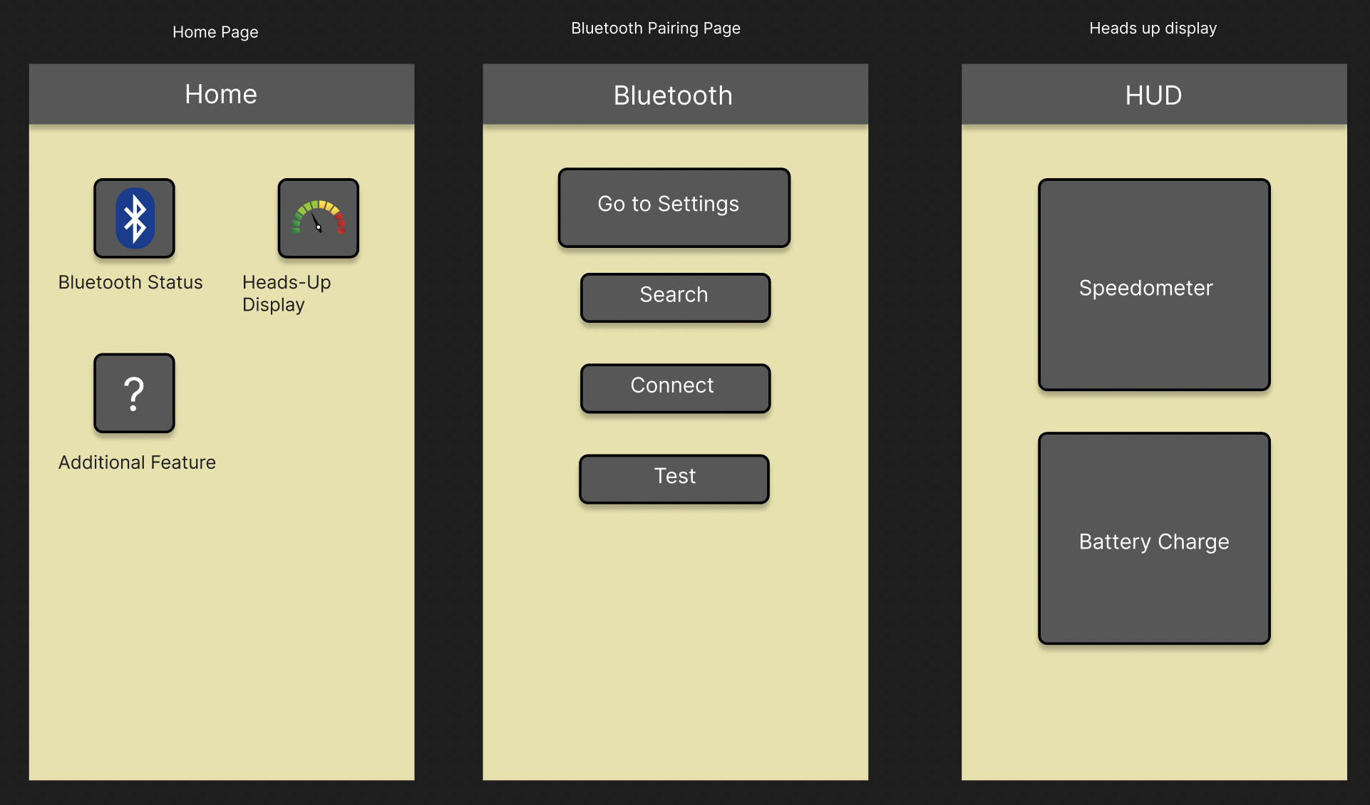
Application Design
To design application prototype, figma.com was utilized
Layered diagrams
Focus on certain keywords when designing:
Simple
Understandable
Modular
Notes:
Figma.com is a great site that, for free, allowed the group to create a skeleton prototype design of the application itself
Mention that how ease of access and simple visuals were key factors when deciding what technology to use, and that mentality extends into the application design as well.
Also place emphasis on the modular keyword, as the home page is built to be modular to support more features if planned/added (such as the proposed light control page)
Also, as a tid bit, mention the color scheme and how its not only a good combination of colors, they also contrast well with another to increase accessibility and legibility. Also maybe mention it’s only appropriate for the school we all attend, UCF

Slide 26
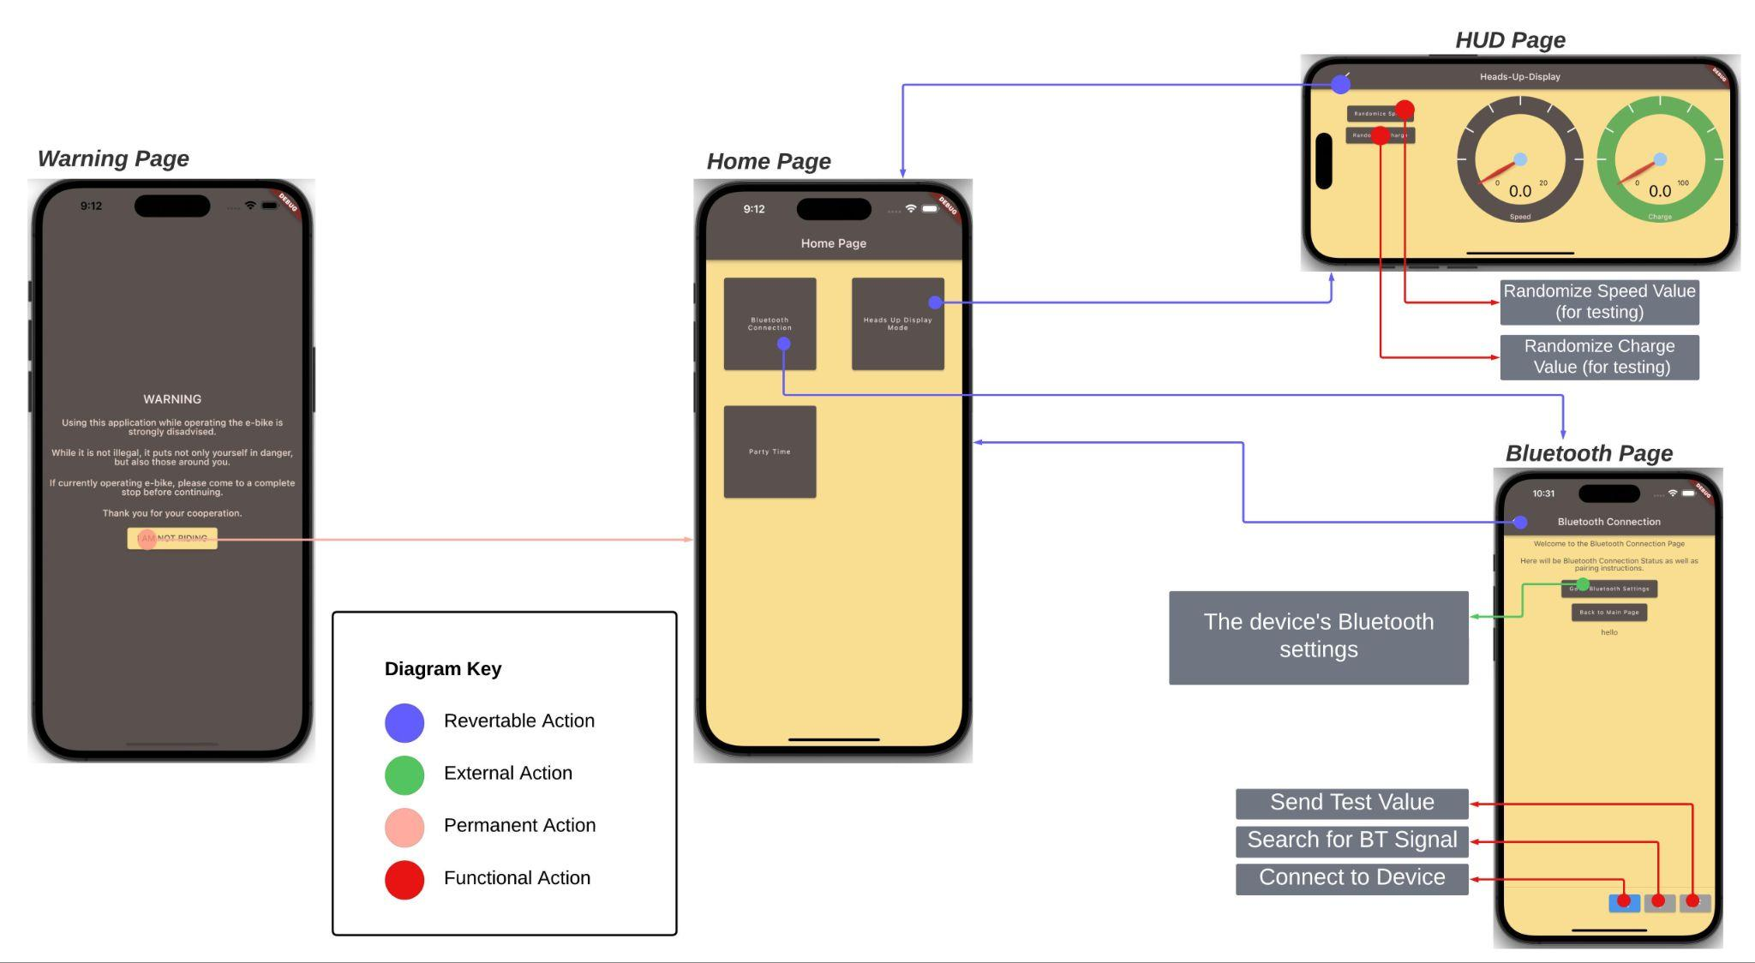
Application Flowchart
Notes:
Here is flowchart of app
Actions are separated into categories in terms of where it takes you (point out diagram key and the colors)
Begins with warning page (plz read)
Leads into home page with a permanent action
Home page takes you to both of the developed pages: the hud page and the bluetooth page
Bluetooth page will be responsible for searching for, finding, and connecting to e-bike’s bluetooth module
HUD page is where data will be displayed in terms of speed and battery charge

Slide 27
Current State of Application
Application is not yet complete, but is making great progress
Pages are built
Navigation between pages is smooth and intuitive
Heads-up-display page does not yet function, however:
A Bluetooth link has been established
Very big hurdle
On-schedule to complete basic functionalities by end of semester
Stretch goals are still just that
Taking steps to try and attain them
Notes:
Although the application isnt complete, it’s making significant progress. The pages are built and the navigation through the app is as fluid and intuitive as expected, however the hud and bluetooth pages will be touched up to provide a more user-friendly experience
Even though the heads up display page does not yet function as intended, a bluetooth link has been established between the application and the bluetooth module. Not only was the application able to search and find the bluetooth module, it was also capable of connecting to it and sending a simple message to toggle LEDs. This was one of, if not the most important, hurdles of the application to overcome.
The application is on schedule to be completed in time for final presentations at the end of July. Even though great progress is being made, the stretch goals the group came up with are still just that: stretch goals. The group would like them to be attained, however the proposed functionality of the bike must be prioritized. Steps are being taken to ensure that if time is allotted for the stretch goals, development can go smoothly.

Slide 28
Administrative Content
Budget
Work Distribution
Progress

Slide 29
Budget
Item | Estimated Price
Motor (1 unit) | $240
PCB (3 – 5 units) | $40
Batteries (1 unit) | $350
Sensors | $50
Circuit components | $50
Forecasted Total | $730

Slide 30
Work distribution
Name | PCB design | App developer | MCU Software | Hardware assembly & Testing
Alex | x
Carlos |  |  |  | x
Chris |  | x
Victor |  |  | x

Slide 31
